Slide 1




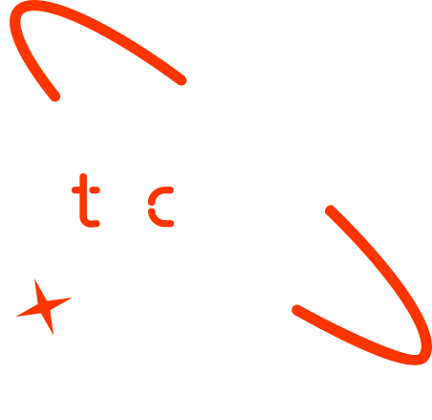

A new generation
of tech specialists

Slide 2
Machine Learning for Assessing Soil Liquefaction Risk in Seismic Zones
Bby :
Wisam Mohamed

Slide 3
Project Description
Risk management project
Directly relevant to SDG 11 (Sustainable Cities and Communities)

Slide 4
Goals and Objectives
Obje
ctive?
Building a liquefaction prediction model By analyzing historical earthquake data and geotechnical parameters
Using the model as a helping tool in mitigating the risks associated with liquefaction
REPORT NO: METU/EERC 2023-01

Slide 5
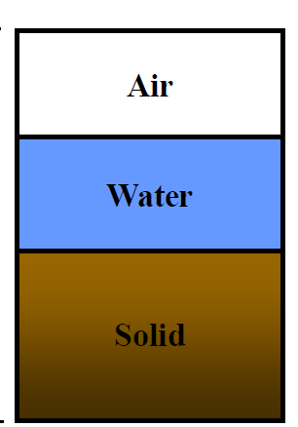
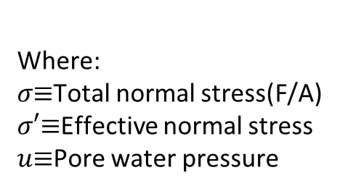
Importance and Rationale
Liquefaction is the process in which a mass of soil loses its strength and starts to behave like a liquid
Need?
Severe damages
Financial burden
$$σ^{′}=σ−u$$
Where:
𝜎≡Total normal stress(F/A)
𝜎′≡Effective normal stress
𝑢≡Pore water pressure
Loose sand
cyclic loading
HIGH GWT
u$↑$
u↑
$σ$ constant
𝜎 constant

Slide 6
The forms of damage
Tilting
Sinking
Floating
Lateral movement
IkuoTowhata , GEE , 2008 Springer

Slide 7
Value Propositions
Traditional methods
Accuracy is limited (because of the complexity of geological formations )
ML Models
transformative opportunity to overcome the accuracy challenges
The evaluation of liquefaction potential
Field methods: SPT, CPT, shear wave velocity
Laboratory methods: triaxial test, cyclic direct simple shear test, centrifuge modeling, shake table test.
Analytical methods
Numerical methods
AI methods

Slide 8
Project Elements
Data Processing
Feature Engineering
Data Normalization
Model Training and Evaluation
Deep Learning Model
Model Deployment and Monitoring
Data Collection
Dataset Splitting
Risk Assessment API

Slide 9
Project Development
data
Collection
Literature:CPT data , SPT and Vs data sets
Processing
EDA
Feature engineering
CRR7.5 calculation
Normalization
StandardScaler
Splitting
training, validation (development), and test sets

Slide 10
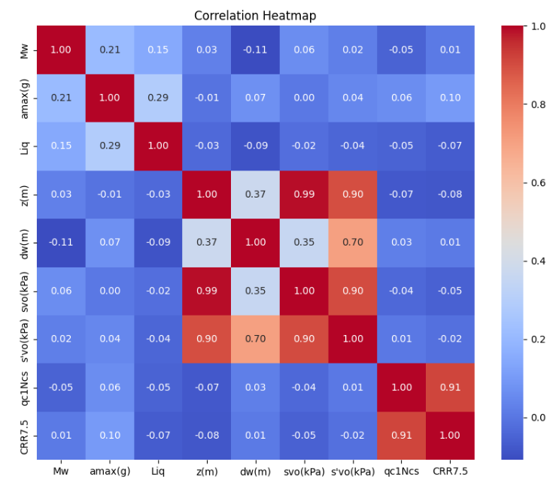
Project Development

Slide 11
Project Development
Model
training
Deep learning model
evaluation
accuracy, precision, recall, F1 score and AUC
deployment
gradio

Slide 12
Model Selection

Slide 13
Model selection
Model_13
L2 regularization
LeakyReLU and tanh
three dense layers
64 and 32 units in the hidden layers
a single-unit output layer
adam optimizer
BCE
batch size of 32
150 epochs
Accuracy (testing)=84.72%

Slide 14
Deployment

Slide 15
Conclusion and Futurework
1. Enhanced Performance:
Refinement and testing phases significantly improved machine learning models for liquefaction susceptibility prediction using CPT data.
2. SPT and Vs Models:
Deep learning models effectively classify liquefaction potential but show lower accuracy compared to CPT models.
3. Future Directions:
Focus on exploring alternative algorithms and refining deep learning models for SPT and Vs datasets to enhance predictive accuracy and robustness.

Slide 16

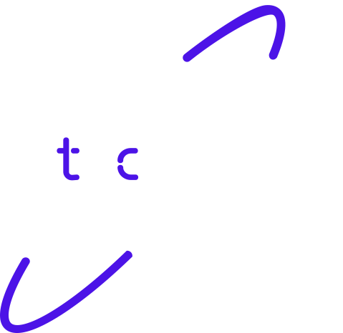
Thank you!

